Slide 1
“Team Console”
Data Structure Final Project
Course Code : CSE - 2322
Course Title : Data Structure Lab
Section : 3AM
Course Teacher : Mohammed Shamsul
Alam
Leader : Gazi Shaharabi Anwar Tuhin
Leader ID : C231035
Member 01 : SM Muntasir Sarwar
Member ID : C231037
Member 02 : Adnan Mahmud Alvee
Member ID : C231022

Slide 2
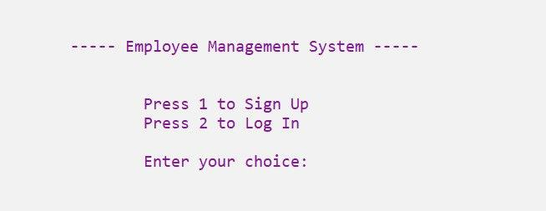
Welcome Page :

Slide 3
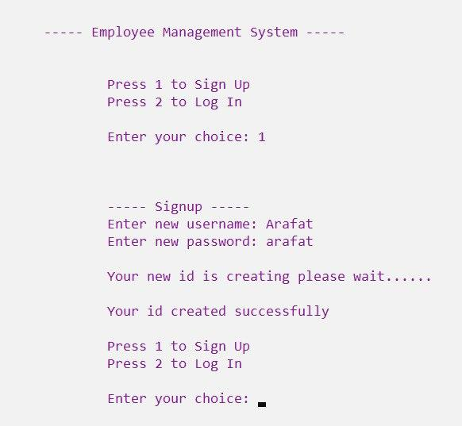
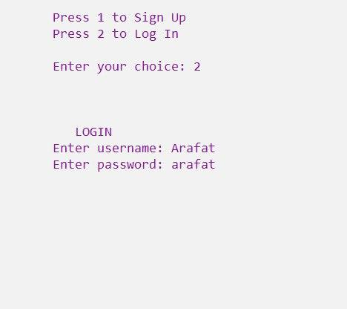
Sign Up Page :
Login Page :

Slide 4
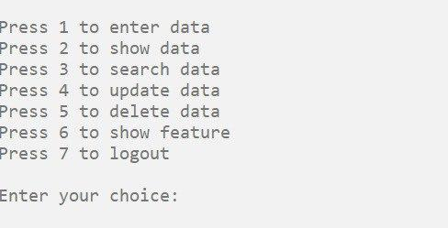
Menu Page :

Slide 5
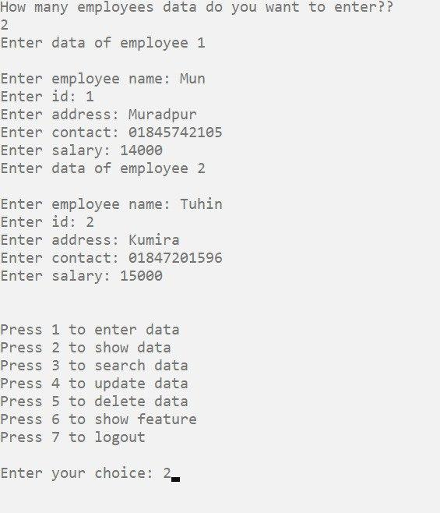
Inserting 02 Employee :
Showing Employee data :

Slide 6
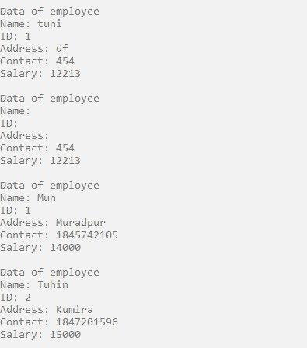
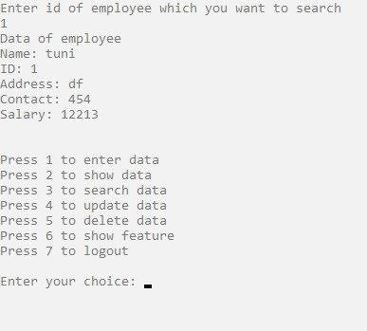
Showing Employee data :
Search Employee data :

Slide 7
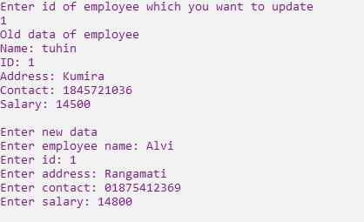
Update Page :

Slide 8
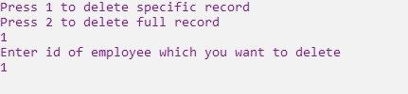
Delete Slide

Slide 9
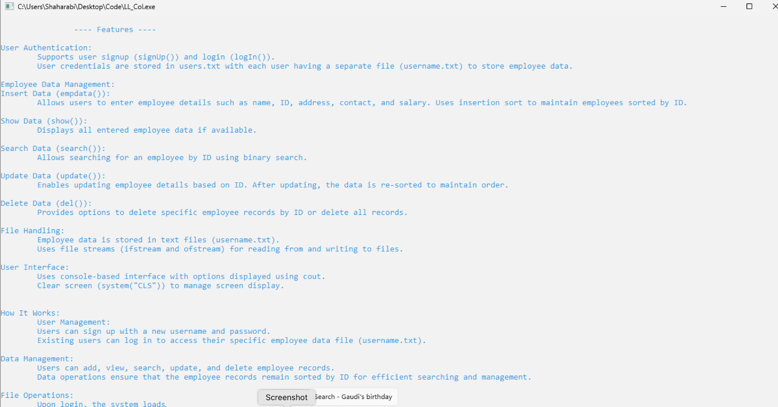
Feature Page :

Slide 10
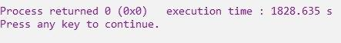
Logout Page :
Thank You!

